Slide 1



PORTFOLIO ANALYTICS
Irish ETF & Crypto Portfolio
Google Sheet Live Tracker
A live, formula-driven Google Sheet for pricing, allocation, and growth tracking across five Irish-domiciled UCITS ETFs and Bitcoin.
Google Sheets · IMPORTHTML · GOOGLEFINANCE · updates automatically
September 2026

Slide 2



Two tabs, one live picture
Everything below lives inside a single Google Sheet — nothing is entered by hand.
TAB 1
TAB 2
Portfolio
Contributions
  Live current price for each of the 6 holdings
  Units held and € value per holding
  Current allocation vs. the client's ideal allocation
  Every contribution logged by date, per holding
  Totals rolled up per holding and for the portfolio
  Growth: current value vs. amount contributed
Tab 2's totals pull each holding's current value live from Tab 1 via cell references.
6
2
0
tracked holdings
connected tabs
manual price updates

Slide 3
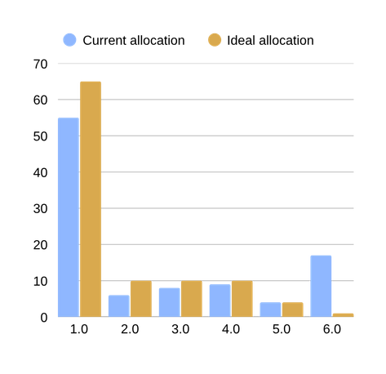
Tab 1 — Live portfolio snapshot
€344.35
total portfolio value
Holding | Price | Current | Ideal
SPPW | €46.24 | 55% | 65%
IQQ0 | €66.80 | 6% | 10%
IWQU | €76.67 | 8% | 10%
IS3S | €71.62 | 9% | 10%
ZPRV | €80.35 | 4% | 4%
BTC | €66,478.97 | 17% | 1%
Total | — | 100% | 100%
Current vs. ideal allocation
The five ETFs price live from Tradegate.de by ISIN; Bitcoin uses GOOGLEFINANCE. See the next slide for how.

Slide 4
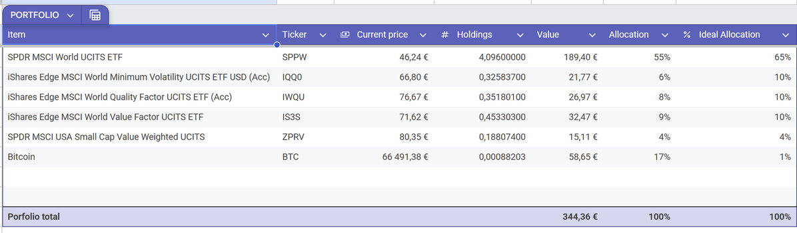
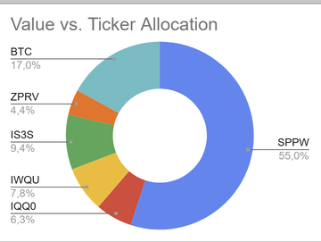
Portfolio tab — as it looks live
Straight from the live Google Sheet — no mockups.
Google Sheets · Portfolio
Chart
Same numbers, one glance
The donut is a native Sheets chart built straight off the allocation column — no extra data prep. It makes the tilt obvious at a glance: SPPW and Bitcoin alone are 72% of the live portfolio (55% + 17%), against a combined 66% ideal.

Slide 5



What keeps the prices live
5 ETFs — IMPORTHTML
Bitcoin — GOOGLEFINANCE
IMPORTHTML pulls the live order-book table straight from Tradegate.de for each ISIN. REGEXEXTRACT, SUBSTITUTE and VALUE parse the traded price out of the page into a usable number.
One native Sheets function, no scraping required. GOOGLEFINANCE returns Bitcoin's live EUR price directly, refreshed automatically like any other cell.
=IMPORTHTML(tradegate_url,"table",3)
=GOOGLEFINANCE("BTC-EUR")
IFERROR — the safety net
Every live-price formula is wrapped in IFERROR. If Tradegate is slow to load or the page structure changes, the sheet falls back to the last known price instead of breaking — the rest of the workbook keeps calculating.

Slide 6
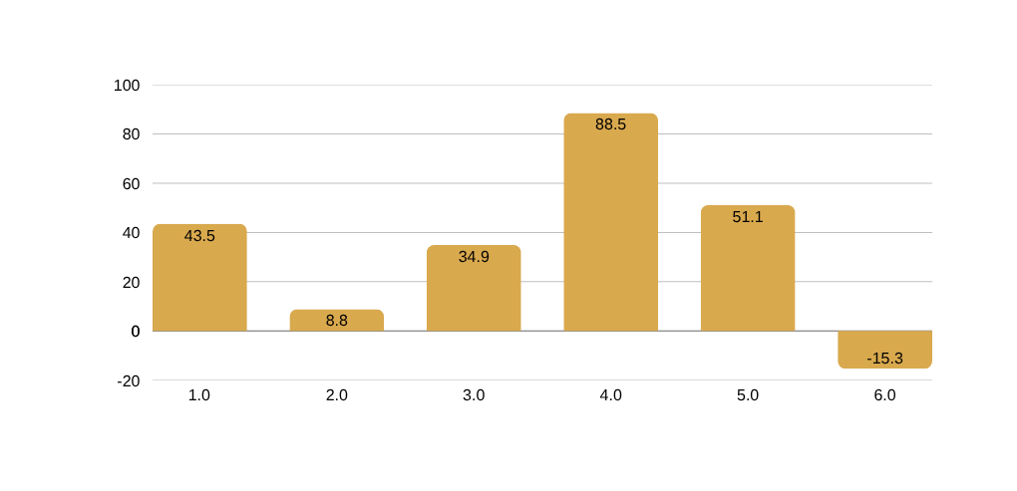
Tab 2 — Contributions & growth
€268.48
€344.35
+28.3%
total contributed
current value
total growth (+€75.87)
Growth by holding since first contribution

Slide 7
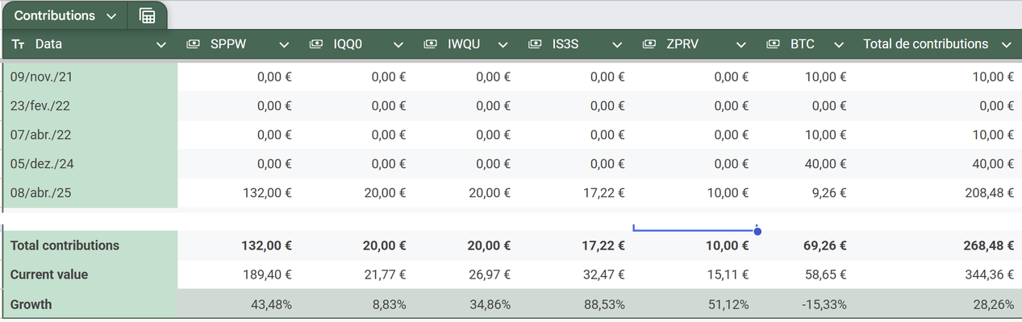
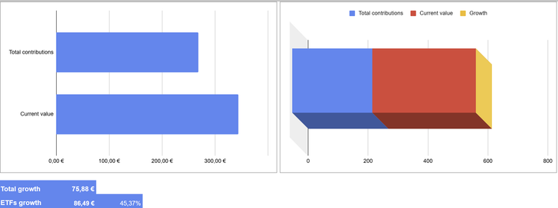
Contributions tab — as it looks live
Every contribution logged, rolled up, and compared automatically.
Google Sheets · Contributions
Chart

Slide 8


Key takeaways
Overall +28.3% since inception
From €268.48 contributed to €344.35 today (+€75.87), led by the ETF sleeve at +45.4% growth.
Bitcoin is the biggest allocation gap
17% of the portfolio vs. a 1% ideal allocation — and currently the only holding in the red, at -15.3%.
IS3S is the standout performer
iShares MSCI World Value Factor UCITS ETF is up +88.5%, the strongest grower on the sheet.
Zero manual maintenance
Live pricing, allocation math, and growth tracking all recalculate automatically, every time the sheet opens.

